Slide 1
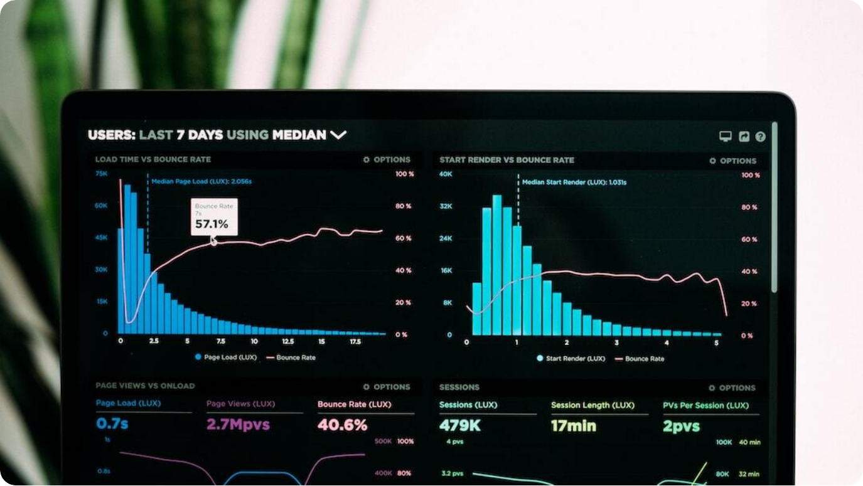
Unit 1 – Point 1.4: Data Types, Measures of Central Tendency, and Measures of Dispersion
Overview
Unit 1 – Point 1.4 Overview: Introduction to core statistical concepts relevant for data analytics: data types, measures of central tendency, and measures of dispersion.
Data Types: Classification of data into qualitative and quantitative categories with further subtypes.
Measures of Central Tendency: Mean, median, and mode as indicators of where the center of data lies.
Measures of Dispersion: Range, interquartile range, variance, and standard deviation to quantify data spread.
Photo by Luke Chesser on Unsplash
Notes:
Today we are covering Point 1.4 of Unit 1, which is the foundation of statistical analysis. We’ll start by learning about data types, then move on to measures of central tendency, which show where data is centered, and finally measures of dispersion, which explain how data is spread out.\n\nThis section sets the base for descriptive statistics. Central tendency shows a ‘typical’ value; dispersion explains variability. Both are essential for data interpretation in analytics.

Slide 2
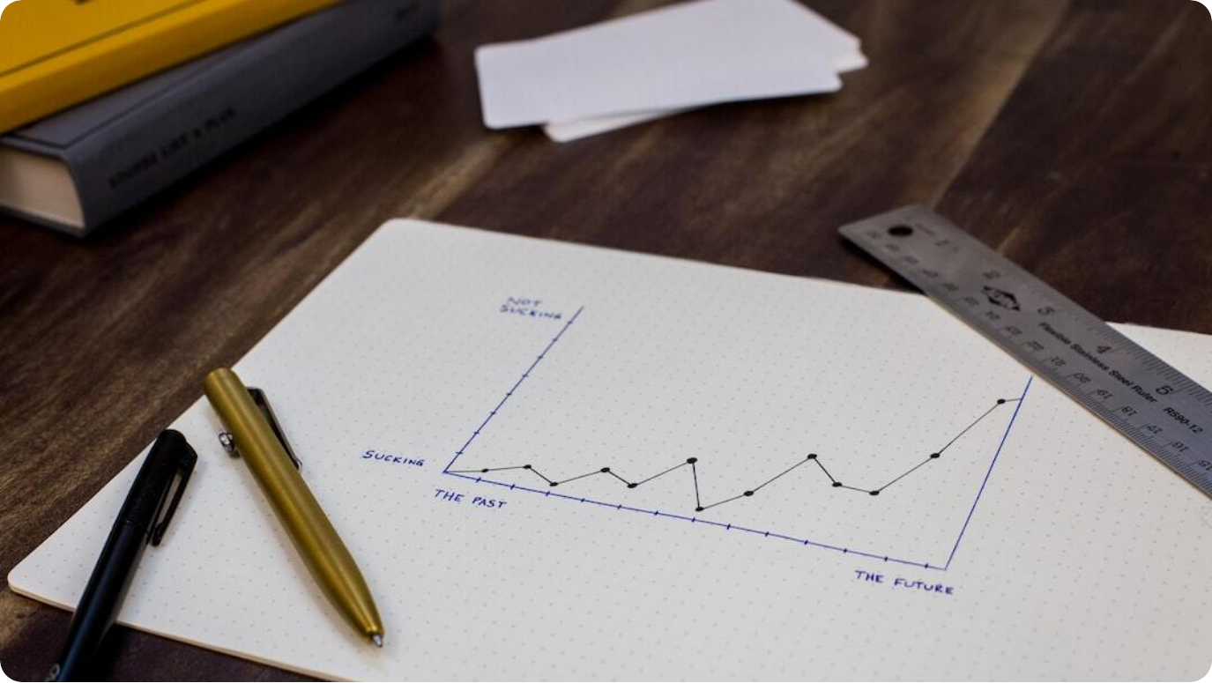
Data Types
Qualitative & Quantitative
Qualitative: Non-numeric, descriptive data such as colors, names, or categories.
Quantitative: Numeric data, further classified into interval and ratio scales.
Structured vs. Unstructured: Structured data stored in rows/columns vs. unstructured text, images, or videos.
Examples: Nominal (gender), Ordinal (rank), Interval (Celsius temperature), Ratio (weight).
Photo by Isaac Smith on Unsplash
Notes:
Data comes in different forms, and choosing the right analysis method depends on the type. Qualitative data is descriptive, like colors or labels, while quantitative data is numeric. Quantitative data can be interval, with equal spacing but no true zero, or ratio, with a meaningful zero point. We also distinguish between structured formats like Excel tables and unstructured formats like social media posts.\n\nNominal data represents categories without order, ordinal data has order but not measurable distance, interval data allows measurement without a true zero, and ratio data has both measurement and a true zero. Structured data is organized in databases, while unstructured data requires preprocessing before analysis.

Slide 3
Introduction to Measures of Central Tendency
Finding the Center of Data
Shows the Center of Data: Central tendency summarizes the middle point of a dataset.
Common Measures: Mean, median, and mode are the primary statistics used.
Purpose: Identifies a representative value to simplify large datasets.
Photo by Luke Chesser on Unsplash
Notes:
Measures of central tendency summarize the center point of a dataset. The most common are mean, median, and mode. These help us understand what’s typical in our data.\n\nThe purpose is to condense large data into a single central value. Mean, median, and mode each have different strengths, and the choice depends on data type and the presence of outliers.

Slide 4
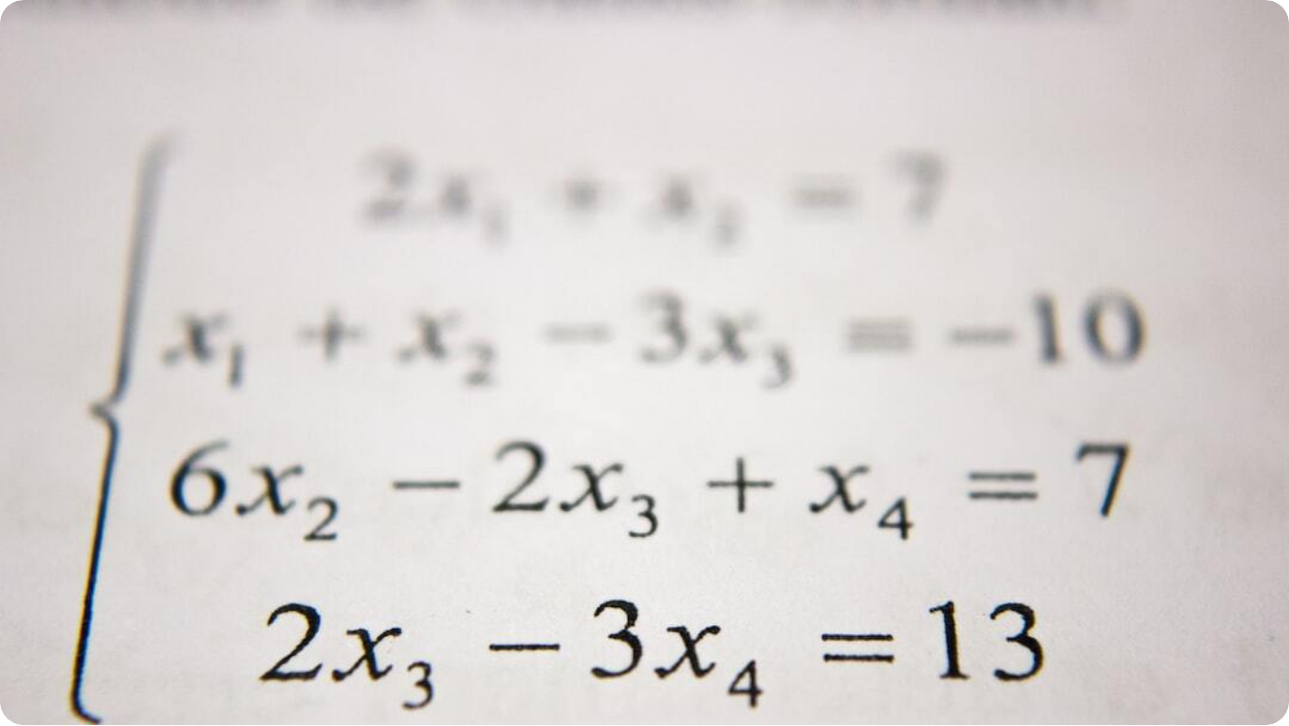
Mean: Concept & Formula
Arithmetic Average
Definition: The mean is the sum of all data values divided by the number of values.
Formula: \(\bar{x} = \frac{\Sigma x_i}{n}\)
Best Use: Works best for balanced, numeric datasets without extreme outliers.
Photo by Antoine Dautry on Unsplash
Notes:
The mean, or average, is found by adding all data values and dividing by how many there are. It’s simple but can be skewed by extreme values.\n\nIt’s sensitive to all values, which makes it very responsive to changes in data but also vulnerable to outliers. Common applications include KPIs and performance tracking.

Slide 5
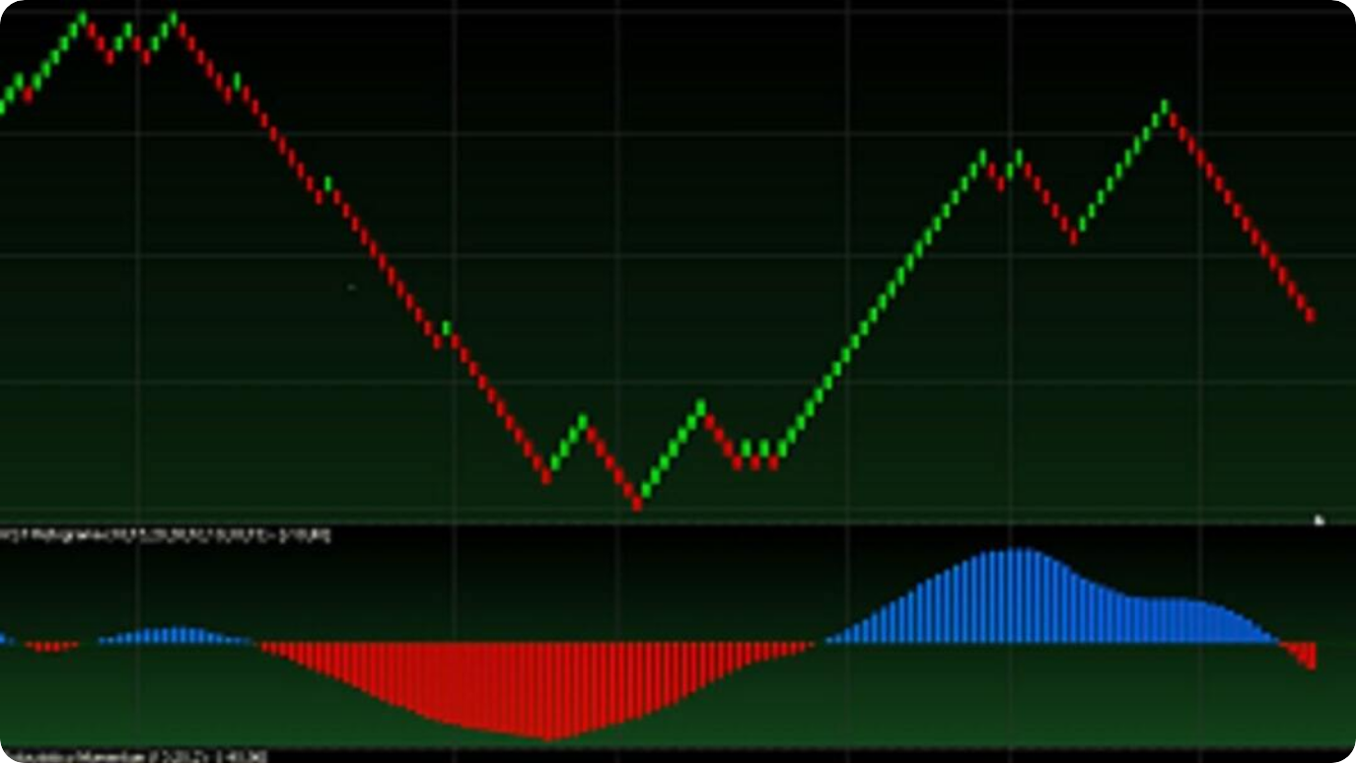
Mean: Graphical Visualization
The Balance Point
Reference Line: The mean can be represented as a horizontal line across data plots.
Balance Point: Acts as the equilibrium where data values balance out.
Symmetry vs. Skew: In symmetric distributions, the mean is central; in skewed data, it shifts toward the tail.
Photo by Jianu tr on Unsplash
Notes:
Graphically, the mean appears as a balance point. In a line or bar chart, it’s a horizontal reference line around which data clusters. In a perfectly symmetric distribution, the mean sits right in the middle. However, in skewed data, the mean shifts toward the tail of the distribution.

Slide 6



Median: Concept & Formula
Middle Value in Ordered Data
Definition
The median is the middle value when data is ordered from smallest to largest.
Even Data Sets
If the dataset size is even, the median is the average of the two middle values.
Resistant to Outliers
Less affected by extreme values compared to the mean.
Notes:
The median is the middle value when data is ordered. If there’s an even number of data points, it’s the average of the two middle values. It’s a better choice than the mean when dealing with skewed data or outliers.\n\nExample: Sorted [1, 2, 4, 6, 9] → median = 4. For even counts, take the mean of the middle pair.

Slide 7

Median: Graphical Visualization
Box Plot Representation
Median Line: Shown as the line inside the box of a box plot.
Data Halves: Splits dataset into two equal parts.
Outlier Detection: Box plots highlight extreme values beyond whiskers.
Photo by National Cancer Institute on Unsplash
Notes:
In a box plot, the median is the line inside the box, dividing the dataset into two equal halves. The box itself shows the interquartile range (IQR), while the whiskers extend to the smallest and largest values within a set range. Outliers beyond the whiskers are marked as individual points, making box plots powerful for identifying skewness and variability.

Slide 8
Mode: Concept & Formula
Most Frequent Value
Definition: The mode is the value that appears most often in a dataset.
Multiplicity: Can be unimodal, bimodal, or multimodal depending on data.
Best Use: Ideal for categorical data and detecting common values.
Photo by Luke Chesser on Unsplash
Notes:
The mode is the most frequent data value. A dataset can have one mode, two modes, or more.\n\nIt’s especially useful for categorical data, where mean and median may not make sense. For example: [2, 4, 4, 5, 7] → mode = 4.

Slide 9
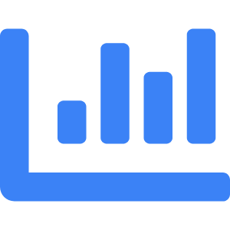


Mode: Graphical Visualization
Frequency Peaks
Histogram Peaks
The highest bar in a histogram represents the mode.
Multiple Modes
Multiple peaks indicate bimodal or multimodal distributions.
Pattern Detection
Modes reveal data clustering and subgroup patterns.
Notes:
In a histogram, the mode is the peak of the distribution — the value with the highest frequency. Histograms can also reveal multiple peaks, which may indicate subgroups within the dataset. This makes mode analysis useful for detecting distinct clusters in data.

Slide 10
Introduction to Measures of Dispersion
Understanding Data Spread
Definition: Measures of dispersion quantify how data points vary around the central value.
Common Measures: Range, interquartile range, variance, and standard deviation.
Purpose: Complements central tendency by showing variability and reliability.
Photo by Isaac Smith on Unsplash
Notes:
Measures of dispersion show how much data varies. They complement central tendency by revealing if data points are close to the center or widely spread. Common measures include range, interquartile range, variance, and standard deviation, each offering unique insights into data variability.

Slide 11
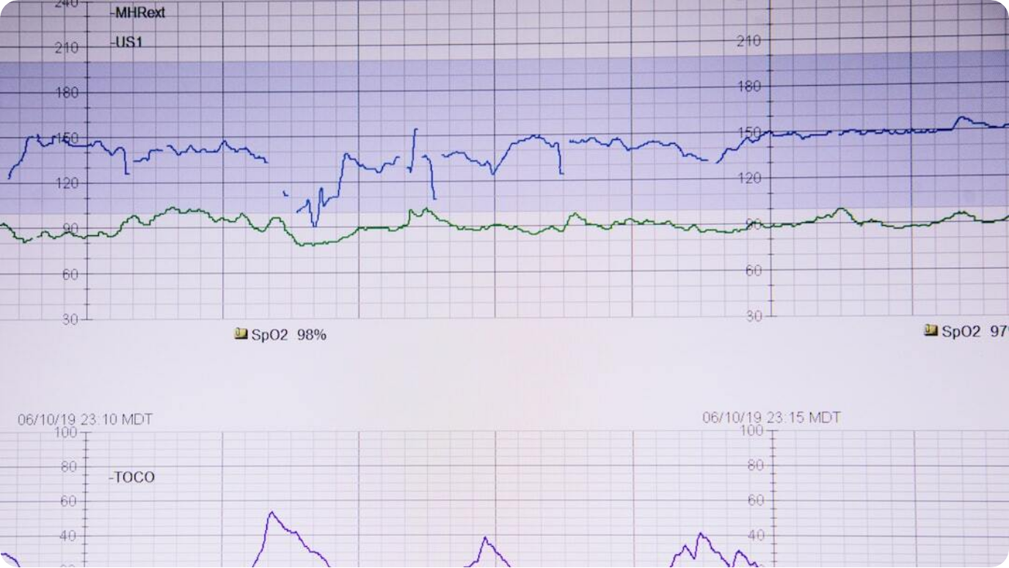
Significance of Understanding Data Spread
Variability and Reliability
Reliability: Data spread affects the consistency of conclusions.
Outlier Detection: Helps identify extreme values that may distort analysis.
Same Mean, Different Spread: Two datasets with identical means can differ significantly in variability.
Photo by Alexander Grey on Unsplash
Notes:
Understanding spread is crucial. Two datasets can have the same mean but very different spreads, leading to distinct interpretations. Low spread means more consistency, while high spread indicates greater uncertainty and potential risk. This is critical in fields like finance, manufacturing, and healthcare.

Slide 12

Range
Simplest Measure of Spread
Formula: Range = Maximum Value − Minimum Value.
Quick Measure: Easy to compute but sensitive to outliers.
Example: [5, 7, 8, 12] → Range = 12 − 5 = 7.
Photo by Sven Mieke on Unsplash
Notes:
Range is the simplest dispersion measure: subtract the smallest value from the largest. While quick to compute, it’s very sensitive to outliers and doesn’t reflect the shape of the distribution.

Slide 13

Interquartile Range (IQR)
Middle 50% Spread
Formula: IQR = Q3 − Q1.
Robustness: Less affected by extreme values than range.
Example: Q1 = 5, Q3 = 15 → IQR = 10.
Photo by Ricardo Arce on Unsplash
Notes:
The interquartile range (IQR) measures the spread of the middle half of the data. It’s calculated as Q3 minus Q1 and is less affected by extreme values than the range. Box plots often display IQR and use it to detect outliers.

Slide 14

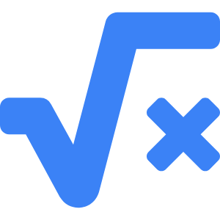

Variance
Average Squared Deviation
Definition
Variance is the mean of squared differences from the mean.
Formula
σ² = Σ(xᵢ − x̄)² / n
Use Cases
Applied in statistical modeling, ANOVA, and risk measurement.
Notes:
Variance measures the average squared distance from the mean. It is expressed in squared units, making it less intuitive than standard deviation, but it’s essential for many statistical models and analyses. Higher variance indicates greater data spread.

Slide 15

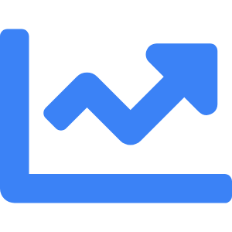
Standard Deviation
Square Root of Variance
Definition
Square root of variance, in the same units as data.
Interpretation
Represents average distance from the mean.
Applications
Quality control, finance risk assessment, and statistical inference.
Notes:
Standard deviation is the square root of variance. It tells us how far data points are, on average, from the mean. For example, σ = √4 = 2 means an average deviation of 2 units. It’s widely used in quality control, finance, and many other fields.

Slide 16
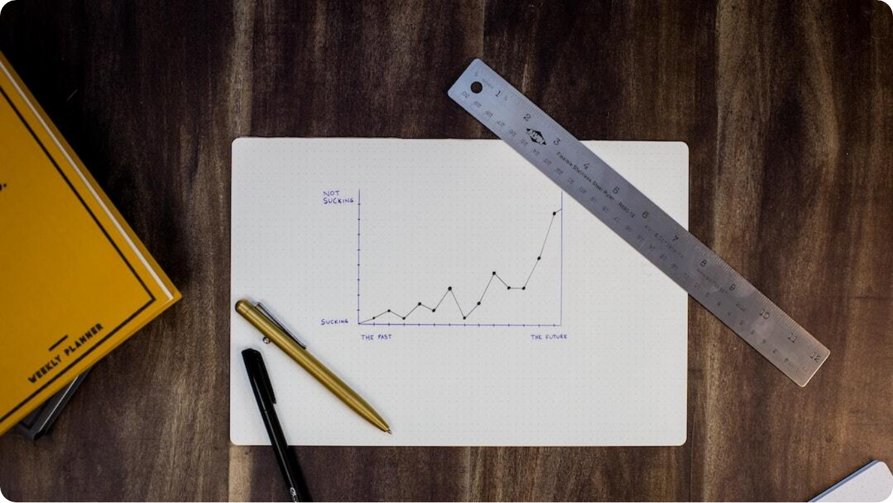
Practical Examples & Visualization Ideas
Dispersion in Action
Box Plots: Show spread, quartiles, and outliers.
Histograms: Display distribution shape and frequency.
Scatter Plots: Reveal variability patterns between variables.
Photo by Isaac Smith on Unsplash
Notes:
Visuals make dispersion easier to understand. Box plots show spread and outliers, histograms illustrate distribution shape, and scatter plots reveal variability patterns across variables. These tools help identify trends, anomalies, and relationships in data.

Slide 17


Summary & Real-World Relevance
Complete Statistical Picture
Central Tendency + Dispersion
Together they provide a holistic understanding of data.
Decision-Making
Essential for accurate forecasting, quality control, and risk assessment.
Practical Applications
Used in business, healthcare, manufacturing, and research.
Notes:
In summary, measures of central tendency tell us where the center of data lies, while measures of dispersion explain how far data points can be from that center. When combined, they offer a complete statistical narrative that’s crucial for analysis and interpretation.\n\nThese concepts underpin accurate decision-making in domains like business forecasting, quality assurance, and risk assessment, enabling professionals to make informed, data-driven choices.

